Slide 1

Social Media Sentiment Analysis

Slide 2


(Approved by AICTE, New Delhi and affliated to VTU Belagavi) No. 50(part) Hootagalli Industrial Area, Koorgalli Village,Mysuru-570018
Department of Information Science Engineering
INTERNSHIP PPT ON
“SOCIAL MEDIA SENTIMENT ANALYSIS”
AT
VARCONS TECHNOLOGY PRIVATE LIMITED
Under the Guidance of Ms. Spoorthi H C, Director of Varcons Technology Private - Limited

Slide 3

Contents
1
Introduction
Dataset
2
Exploring The Data
Exploring Our Data in terms of Letter Frequency
Exploring Our Data in terms of Word Frequency
Embedding - Glove
Feature Extraction - Scatter Plot
3
Predictive Analysis
Entropy
Classification/Regression
LSTM Model - 1
Evaluation Metrics of LSTM Model - 1
LSTM Model - 2
Evaluation Metrics of LSTM Model - 2
LSTM Model - 1 and LSTM Model - 2
CNN Model - 1
Evaluation Metrics of CNN Model - 1
CNN Model - 2
Evaluation Metrics of CNN Model - 2
CNN Model - 1 and CNN Model - 2
Multinomial Naive Bayes with Count Vectorizer
Multinomial Naive Bayes with TF-IDF
Statistical Significance Analysis
4
Descriptive Analytics
Project Delivery #5 - Descriptive Analytics
Instance Distribution - Pie Charts
Evaluation of Experiments - Experiment 1 Number of Clusters = 2
Evaluation of Experiments - Experiment 2 Number of Clusters = 3

Slide 4

Introduction
Sentiment analysis, a sub-field of Natural Language Processing, is one of the most popular topics and research fields in data science. We will be working on social media sentiment analysis. We aim to be able to classify tweets, reviews and comments from social media as positive, negative or neutral. .
The most important point of our project is data mining to collect a large amount of data from several sources. For this purpose, we found open source datasets such as Sentiment140 [1] and many others. Besides, we would like to collect our own data from social media and expand our dataset. We also found some tools and APIs to retrieve new data. TWINT - Twitter Intelligence Tool [2] is an advanced Twitter scraping tool written in Python that allows for scraping tweets. One of the most important features of TWINT is that there is no need to use Twitter Developer API. This feature allows collecting data with no rate limitations.
Most of the open-source datasets that we found on the internet are properly labeled and structured. Data collected by ourselves need to be properly labeled. Then, we will go through the cleaning, preprocessing and separation of test and training data steps.
We searched for some tools for our project and found some popular and powerful open-source NLP frameworks in Python. We will probably use Natural Language Toolkit (NLTK) [3]. It comes with all the pieces you need to get started on sentiment analysis

Slide 5
Libraries Used
RE(Regular expression)-A Regular Expressions (RegEx) is a special sequence of characters that uses a search pattern to find a string or set of strings.
Pandas-It is used to analyze data. It has functions for analyzing, cleaning, exploring, and manipulating data
NumPy-used for working with arrays. It also has functions for working in domain of linear algebra, Fourier transform, and matrices.
Seaborn- Seaborn is a Python data visualization library based on matplotlib. It provides a high-level interface for drawing attractive and informative statistical graphics.
Matplotlib-It is a comprehensive library for creating static, animated, and interactive visualizations in Python. Matplotlib makes easy things easy and hard things possible

Slide 6

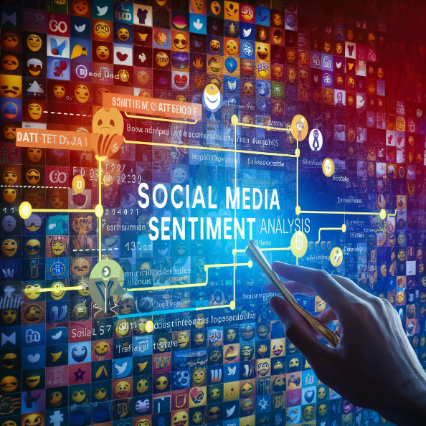
what is the use of social media sentement analysis in machine learning
Social media sentiment analysis with machine learning is like having a giant ear to the ground, helping understand what people are feeling about various topics. Here are some key uses:
Brand Monitoring: Companies can track sentiment around their brand, products, or marketing campaigns. This helps them see if people are happy, what features they like, or if there are any areas for improvement.
Customer Service: By analyzing social media sentiment, companies can identify frustrated customers and reach out to them quickly to address their concerns.
Product Development: Social media analysis can help identify what features resonate with people and what problems customers are facing. This can inform the direction of new product development.
Public Relations: Understanding public sentiment on social media can help shape PR strategies and messaging during crisis situations.
Election Predictions: Social media analysis can be used to gauge public opinion on political candidates and issues, although it's not always perfect.
Overall, social media sentiment analysis with machine learning helps businesses and organizations:
Gain insights: Understand what people are feeling and talking about.
Make better decisions: Use data-driven insights to improve products, services, and communication.
Respond effectively: Identify and address customer concerns and negative sentiment.

Slide 7
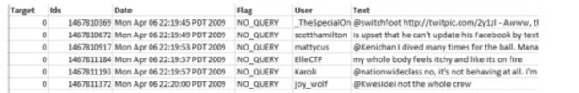
Dataset
The dataset contains 1,600,000 tweets extracted using the twitter api. The tweets have been classified from 0 (negative) to 4 (positive). The dataset contains 6 fields which are target as integer, ids as integer, date as date, flag as string, user as string and text as string. These 6 fields are shown below
● target: The polarity of the tweet (0 - negative, 2 - neutral, 4 - positive)
● ids: The id of the tweet.
● date: The date of the tweet.
● flag: The query. If there is no query, then this value is NO_QUERY.
● user: The user that tweeted.
● text: The text of the tweet

Slide 8

Data Preprocessing
target: The polarity of the tweet (0 - negative, 2 - neutral, 4 - positive)
The dataset has a dimension of 1600000×2 after necessary data reduction is applied
We loaded a dataset containing tweets and performed various preprocessing steps such as removing unnecessary columns, converting labels, and cleaning text data by removing stopwords, punctuations, and URLs.

Slide 9
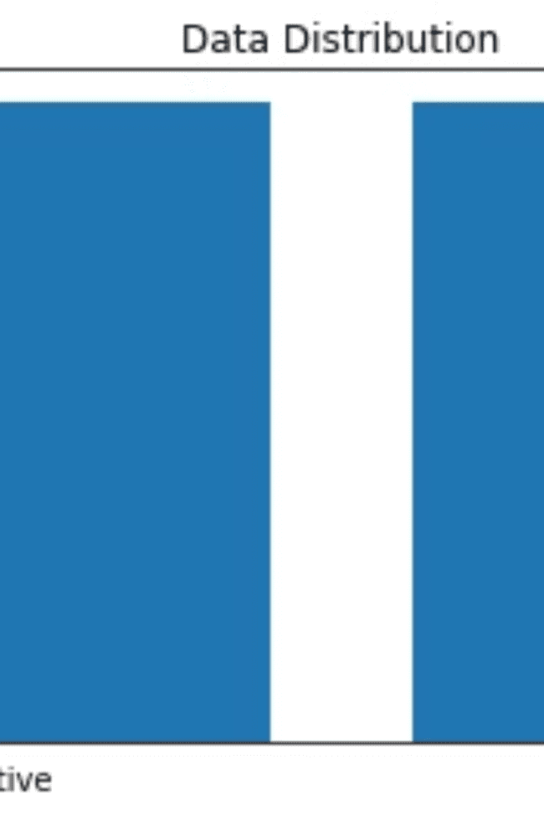
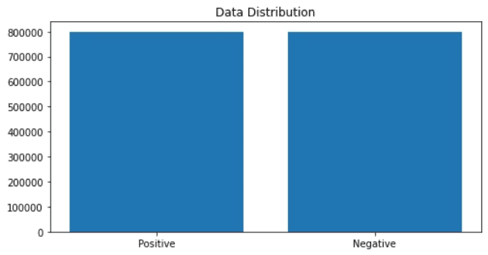
Data Distribution
Positive and negative samples are equal. The dataset distribution has not anyskewness

Slide 10

Data Distribution
count: 1.592328e+06 This represents the total number of data points or tweets in the dataset, which is approximately 1,592,328.
mean: 4.279740e+01 This is the mean or average value of the dataset, which is approximately 42.80.
std: 2.415896e+01 This is the standard deviation of the dataset, which is approximately 24.16.
min: 1.000000e+00 This is the minimum value in the dataset, which is 1.
25%: 2.300000e+01 This is the 25th percentile value, which means 25% of the data points have a value less than or equal to 23.
50%: 3.900000e+01 This is the 50th percentile value, or the median, which means 50% of the data points have a value less than or equal to 39.
75%: 6.000000e+01 This is the 75th percentile value, which means 75% of the data points have a value less than or equal to 60.
max: 1.890000e+02 This is the maximum value in the dataset, which is 189.
dtype: float64 This indicates that the data type of the values in the dataset is float64, which is a 64-bit floating-point number.
What is datapoints and Dataset ?
In the context of this dataset, the "data points" or "data instances" refer to the individual tweets that make up the dataset.
So when the summary statistics mention:
"count: 1.592328e+06"
This means that the dataset contains approximately 1,592,328 individual tweets or data points.
Each tweet is considered a single data point or instance in the dataset, and the statistical summary is providing various metrics (mean, standard deviation, percentiles, etc.) to describe the characteristics of these 1.592328 million tweets.
The "data points" terminology is commonly used in data analysis and machine learning to refer to the individual observations, samples, or records that make up a dataset. In this case, the data points are the individual tweets that have been collected and classified.
For Example:
Imagine you have a dataset of 10 people's heights, and the values are:
170, 165, 175, 160, 162, 168, 172, 163, 171, 167
In this case, each person's height is a "data point" or an individual observation in the dataset.
The key statistics for this dataset would be:
Count: 10
This means there are 10 data points (heights) in the dataset.
Mean: 168.0
This is the average height, calculated by adding up all the heights (1700) and dividing by the total number of data points (10).
Standard Deviation: 4.52
This measure shows how spread out the heights are from the mean value.
Minimum: 160
The shortest height in the dataset.
25th Percentile: 163.5
25% of the data points (heights) are less than or equal to this value.
50th Percentile (Median): 168.0
50% of the data points (heights) are less than or equal to this value.
75th Percentile: 171.0
75% of the data points (heights) are less than or equal to this value.
Maximum: 175
The tallest height in the dataset.
So in summary, the "data points" are the individual observations (heights in this case), and the statistical summary provides insights into the distribution and characteristics of those data points.

Slide 11

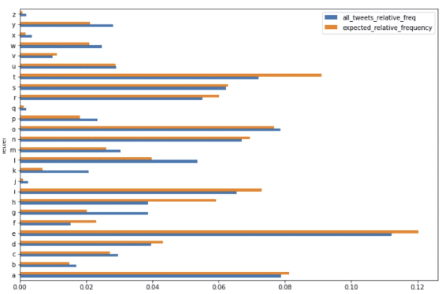
Exploring Our Data in terms of Letter Frequency
Number of letters
Letter frequencies of each 26 characters in English Alphabet.
We provide the frequency and the relative frequency of the letters of the wholetweets. Finally, we will apply a chi-square test to test if the distribution of the lettersin tweets is the same with what we see in English texts.
all_tweets_relative_frequency:
This refers to the relative frequency of each letter in the entire dataset of tweets.
Example :
iSuppose you have a dataset of students' exam scores:
It represents the percentage or proportion of each letter's occurrence in the total text of all the tweets.
Exam Scores: 70, 85, 90, 75, 85, 90, 80, 90, 85, 75
The frequency of the score "85" is 3 because it appears three times in the dataset.
This is calculated by counting the number of occurrences of each letter in the dataset and dividing it by the total number of characters across all tweets.
The frequency of the score "90" is 3 because it also appears three times.
Similarly, the frequency of the score "75" is 2, and so on.
Relative Frequency:
expected_relative_frequency:
Relative frequency refers to the proportion or percentage of times a particular event or observation occurs relative to the total number of events or observations in the dataset.
This refers to the expected relative frequency of each letter according to the English language.
Example: Using the same dataset of students' exam scores:
The total number of scores is 10.
It represents the typical or average relative frequency of letters as observed in standard English text.
The relative frequency of the score "85" is 3/10 or 0.3, which means 30% of the scores are 85.
The relative frequency of the score "90" is also 3/10 or 0.3, indicating that 30% of the scores are 90.
These expected frequencies are based on statistical analysis of large corpora of English language text.
Similarly, the relative frequency of the score "75" is 2/10 or 0.2, meaning 20% of the scores are 75.
Comparison:
Frequency tells us how many times something occurred.
Relative frequency tells us the proportion or percentage of times something occurred relative to the total.

Slide 12

Letter
Frequency
all_tweets_relative_freq
expected_relative_frequency
expected
a
4547601
0.078816
0.081238
4687379.0
b
975326
0.016904
0.014893
859300.0
c
1705409
0.029557
0.027114
1564464.0
d
2289515
0.039680
0.043192
2492128.0
e
6471295
0.112156
0.120195
6935169.0
f
878849
0.015232
0.023039
1329304.0
g
2231747
0.038679
0.020257
1168838.0
h
2234047
0.038719
0.059215
3416628.0
i
3779579
0.065505
0.073054
4215160.0
j
143817
0.002493
0.001031
59502.0
k
1197291
0.020751
0.006895
397842.0
l
3095498
0.053649
0.039785
2295581.0
m
1754377
0.030406
0.026116
1506861.0
n
3861185
0.066919
0.069478
4008801.0
o
4534414
0.078587
0.076812
4431963.0
p
1351301
0.023420
0.018189
1049517.0
q
115059
0.001994
0.001125
64883.0
r
3179237
0.055100
0.060213
3474231.0
s
3595565
0.062316
0.062808
3623936.0
t
4153946
0.071993
0.090986
5249801.0
u
1676743
0.029060
0.028776
1660364.0
v
566733
0.009822
0.011075
639015.0
w
1422401
0.024652
0.020949
1208717.0
x
203131
0.003521
0.001728
99698.0
y
1620980
0.028094
0.021135
1219478.0
z
114027
0.001976
0.000702
40512.0

Slide 13

Compare the Observed Frequencies with the Expected Frequencies in English
We get that the p-value (p) is 0 which implies that the letter frequency does not follow the same distribution with what we see in English tests, although the Pearson correlation is too high (~96.7%).
frequency
expected
frequency
1.000000
0.967421
expected
0.967421
1.000000
Example:
let's go through an example to understand the chi-square test better.
Suppose we have a dataset of 100 students, and we want to test whether the gender distribution of the students is different from the expected gender distribution in the general population.
Let's say the observed gender distribution in the student dataset is:
60 female students 40 male students And the expected gender distribution in the general population is:
50% female 50% male To perform the chi-square test, we'll follow these steps:
Set up the null and alternative hypotheses: Null hypothesis (H0): The gender distribution of the students is the same as the expected gender distribution in the general population. Alternative hypothesis (H1): The gender distribution of the students is different from the expected gender distribution in the general population.
Calculate the expected frequencies based on the null hypothesis:
Expected female students = 100 * 0.5 = 50
Expected male students = 100 * 0.5 = 50
Calculate the chi-square test statistic:
χ² = Σ (Observed - Expected)² / Expected
χ² = (60 - 50)² / 50 + (40 - 50)² / 50
χ² = 2.0 + 2.0 = 4.0
Determine the degrees of freedom:
Since we have 2 gender categories, the degrees of freedom is (2 - 1) = 1.
Look up the p-value:
With 1 degree of freedom and a chi-square statistic of 4.0, the p-value is approximately 0.046.
Interpret the results:
The p-value of 0.046 is less than the commonly used significance level of 0.05.
Therefore, we can reject the null hypothesis and conclude that the gender distribution of the students is significantly different from the expected gender distribution in the general population. In this example, the chi-square test reveals that the observed gender distribution in the student dataset is statistically different from the expected gender distribution in the general population.
In this example, the chi-square test reveals that the observed gender distribution in the student dataset is statistically different from the expected gender distribution in the general population.
The key aspects of the chi-square test are:
Comparing observed and expected frequencies
Calculating the chi-square statistic based on the differences
Determining the p-value and comparing it to the significance level
Drawing conclusions about the statistical significance of the differences

Slide 14

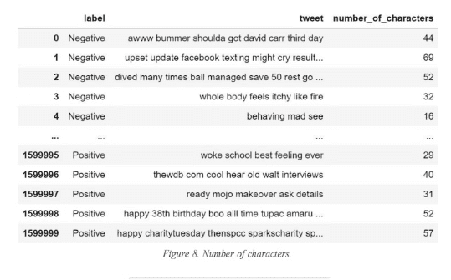
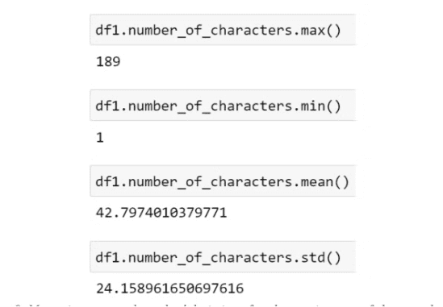
Exploring Our Data in terms of no of characters
We counted the number of characters for each tweet and analyzed the data frame according to maximum number of characters, minimum number of characters, mean of the number of characters column and its standard deviation. Our longest tweet is 189 characters long, the shortest tweet is 1 character long and mean of all tweets’ character length 42.78. The standard deviation of all tweet character length is 24.16
Number of characters
Max, min, mean and standard deviation of each tweet in terms of character length.

Slide 15

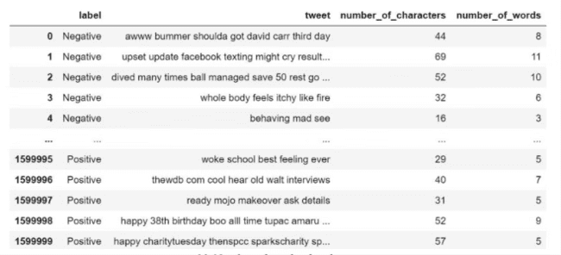
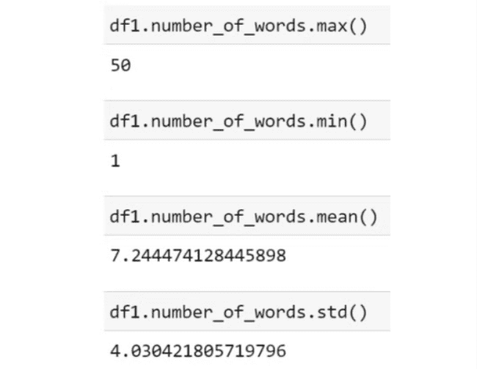
Exploring Our Data in terms of Word Frequency
Number of words of each tweet.
Max, min, mean and standard deviation of each tweet in terms of number of words.

Slide 16
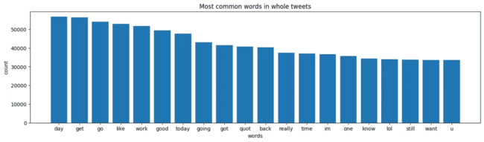

Slide 17
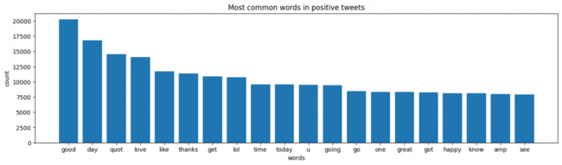

Slide 18
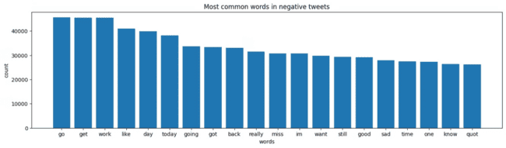

Slide 19
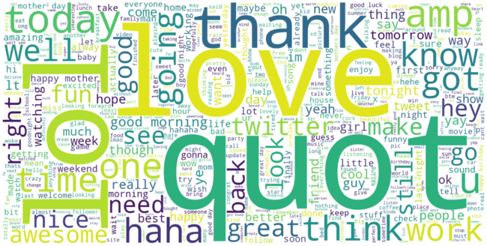
The larger the word, the more frequently it appears in the positive tweets.

Slide 20
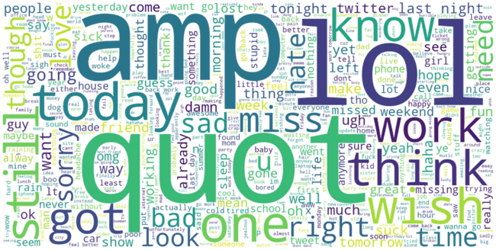
The larger the word, the more frequently it appears in the negative tweets.

Slide 21

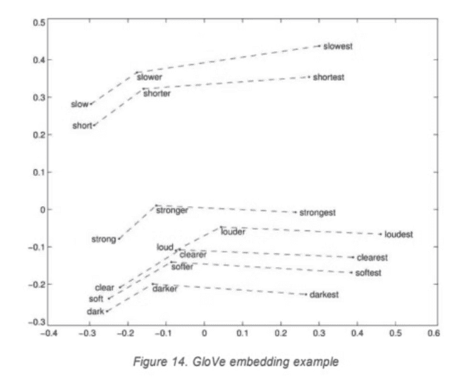
GloVe (Global Vectors for Word Representation)
In natural language processing (NLP), Embedding refers to a technique for representing words or phrases as vectors. These vectors are essentially numerical arrays that capture the semantic meaning and relationships between words. Word embedding allows us to process text data numerically, which is much more efficient for tasks like machine learning.
Example:
Imagine you're trying to teach a computer to understand synonyms. Here's how word embeddings, specifically GloVe, could help:
Building a Word Neighborhood:
Think of a sentence like "The king wore a golden crown." GloVe would look at nearby words for "king" - in this case, "wore" and "crown." These words appear close together often, making them "neighbors" for "king".
2. Analyzing the Neighborhood:
Now, imagine another sentence: "The queen wore a beautiful crown." Similar to "king," GloVe would see "wore" and "crown" as neighbors for "queen."
3. Making Connections:
Since both "king" and "queen" share similar neighbors ("wore" and "crown"), GloVe creates a connection between them. It understands that "king" and "queen" are somehow related, even though they aren't exactly the same word.
4. Capturing Meaning in Numbers:
GloVe takes these connections and turns them into numbers. Each word gets its own unique set of numbers, like a special code. Words with similar meanings will have codes that are close to each other. So, how is this useful?
Imagine the computer is reading a new sentence: "The prince needs a hat." Based on the codes, the computer can see that "prince" is similar to "king" (both royalty), and "hat" is similar to "crown" (both headwear). Using this knowledge, the computer might guess that the prince, like the king, needs something for his head. This is a simplified example, but it shows how GloVe captures the meaning of words by looking at how they are used together. It creates a numerical representation of words and their relationships, allowing computers to better understand the nuances of language.

Slide 22

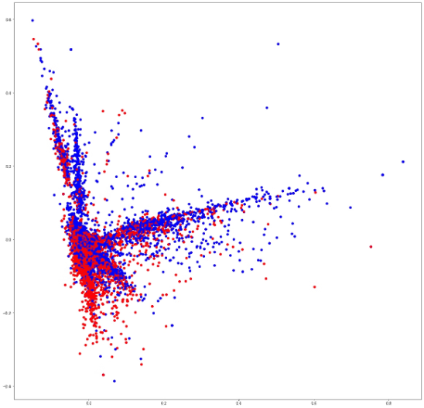
Feature Extraction - Scatter Plot
Scatter plot that shows correlation of words in the corpus: red indicates negatives, blue indicates positives.
Feature extraction is a technique used in machine learning to identify and extract important information from raw data. In the case of text data, features might be individual words or groups of words.
Bag-of-words is a common approach to feature extraction for text. It treats a document as a collection of words, ignoring grammar and word order. Each word is considered a feature, and the frequency of each word in the document is counted.
TF-IDF (term frequency-inverse document frequency) is a way to weight the features extracted from text data. Words that appear often in a single document but not in many documents overall are considered more important features. This is because they are more likely to be relevant to the content of that specific document.
The scatter plot in the image shows the correlation between these features (words) according to the TF-IDF weighting. Words are plotted based on two measures:
X-axis: TF-IDF weight of the word in a specific document
Y-axis: TF-IDF weight of the word across the entire corpus (all documents)
The color of the point corresponds to the sentiment of the word:
Red: Negative sentiment
Blue: Positive sentiment
By looking at the scatter plot, we can see which words tend to appear together in documents that have similar sentiment. For example, if we see a cluster of red dots in the upper right corner, this would indicate that there are words that frequently appear together in documents with a negative sentiment, and that these words also tend to have a high TF-IDF weight overall (i.e. they are important words across the corpus).
Example:
Let's take a much simpler example with just three short documents:
Doc 1: "I love pizza! It's the best food ever." (Positive)
Doc 2: "This movie was awful. The acting was terrible." (Negative)
Doc 3: "I made a delicious cake today. It's chocolate." (Positive)
Feature Extraction: Here, our features are individual words. We get: "I", "love", "pizza", "best", "food", "ever", "this", "movie", "awful", "acting", "terrible", "made", "delicious", "cake", "today", "chocolate".
TF-IDF:
Consider "love" - It appears once in Doc 1 (positive) but not at all in the other documents. So, TF (term frequency) for "love" in Doc 1 would be 1, and IDF (inverse document frequency) would be high because it's only in one document. This gives "love" a high TF-IDF weight for Doc 1, potentially indicating a positive sentiment.
Consider "awful" - It appears once in Doc 2 (negative) but not in the others. Similar to "love", "awful" would have a high TF-IDF weight for Doc 2, suggesting a negative sentiment.
Scatter Plot (Imagine this, not an actual plot):
X-axis: TF-IDF weight of the word in a specific document (Doc 1, 2, or 3).
Y-axis: TF-IDF weight of the word across all documents (all 3 documents here).
Words like "love" and "awful" would likely be far apart in the plot. "Love" might be in the upper right corner for Doc 1 (high TF-IDF in that document, uncommon overall) while "awful" might be in the upper right for Doc 2 (high TF-IDF in Doc 2, uncommon overall). This visually shows how these words hold weight in their respective documents and helps categorize the sentiment.
By analyzing all the words this way, we can see which words tend to appear in positive documents (like "love", "delicious") and which appear more in negative ones (like "awful", "terrible"). This helps us understand the sentiment of new documents based on the features (words) they contain.

Slide 23

Entropy
Entropy is a concept borrowed from information theory that measures the level of uncertainty or disorder in a dataset. In simpler terms, it reflects how mixed up or random the data is. A higher entropy indicates a more uncertain and unpredictable dataset, while a lower entropy signifies a more organized and predictable one.
At the beginning, our dataset had 6 features which were target, id, date, query, user and text. We chose two of them for our purpose which are target and text. We can see that the entropy decreases significantly after thistransformation.
● First entropy of dataset = 41.08269441306875
● Entropy after preprocess = 14.73368002815221
Imagine a box filled with different colored balls (representing data points) and you want to find all the red ones (representing the target class). Initially, the box also contains blue, green, yellow balls (irrelevant features). This makes it difficult to find the red balls quickly (high uncertainty). However, by removing the non-red balls, you're left with a smaller set where finding the red ones becomes easier (lower uncertainty).

Slide 24

Classification/Regression
Test Set Percentage:
You've chosen to split your data into 80% training data and 20% test data. This is a common split, where the training data is used to train the models, and the unseen test data is used to evaluate their performance on unseen examples.
Algorithms and Models:
You're experimenting with six different models across three algorithms for text classification:
Algorithms:
LSTM (Long Short-Term Memory): A type of recurrent neural network (RNN) powerful at handling sequential data like text. You've tried two variations with different batch sizes (1024 and 512). Batch size refers to the number of samples processed at once during training.
CNN (Convolutional Neural Network): Another powerful neural network architecture, often used for image recognition, but also adaptable to text data. Similar to LSTM, you've experimented with two batch sizes (1024 and 512).
Multinomial Naive Bayes: A simpler classification algorithm based on Bayes' theorem. You've tested it with two different text vectorization techniques: Count Vectorizer and TF-IDF Vectorizer.
Text Vectorization:
Count Vectorizer: Converts text data into numerical features by simply counting the occurrences of each word in a document.
TF-IDF Vectorizer: Similar to Count Vectorizer, but it weights the words based on their importance in the document and overall corpus. This can be helpful when some words are very common and don't provide much discriminatory power.
what is batch size?🤔
In the context of machine learning, especially when training neural networks, batch size refers to the number of samples processed at a time during training. It essentially determines how much data the model sees at once to update its internal parameters and learn.
Here's a breakdown of how batch size works:
Training data is split into smaller chunks called batches. Imagine you have a large dataset of images for training a cat vs dog classifier. Batching divides this data into smaller sets of, say, 32 or 64 images each.
Example:
imagine you want to classify emails as spam or not spam.
Data: You have a collection of emails.
Test/Train Split: You split the data into 80% training data (emails used to train the models) and 20% test data (unseen emails used to evaluate the models).
Algorithms and Models: You'll test different models to see which works best for classifying spam:
Simple Model (Multinomial Naive Bayes): Imagine a simpler model that analyzes each word in an email and assigns a "spam score" based on how often that word appears in spam emails compared to regular emails. This is similar to how Naive Bayes with vectorizers works.
Complex Model (LSTM): Imagine a more advanced model that can learn the patterns of words appearing together in spam emails. This is similar to how LSTMs work. Here, you might also experiment with different "batch sizes" which affect how the model trains on chunks of data at a time (like processing 10 emails at once vs 5 emails at once).
Text Vectorization (for Naive Bayes only):
Option 1 (Count Vectorizer): This is like making a simple checklist of all the words in each email and counting how many times each word shows up.
Option 2 (TF-IDF Vectorizer): This is like giving more weight to words that are uncommon overall but appear often in spam emails, compared to very common words like "the" or "to" that might not be very helpful for classification.
Experiment and Evaluation:
You train all the models (Simple Naive Bayes, Complex LSTM with different batch sizes) on the training data.
Then, you use the unseen test data to see how well each model performs at classifying new emails as spam or not spam.
You compare the models' accuracy (percentage of emails correctly classified) and other metrics to see which one performs best.
By comparing these models, you can identify the best approach for classifying your emails as spam or not spam. This is the general idea behind your experiment design!

Slide 25

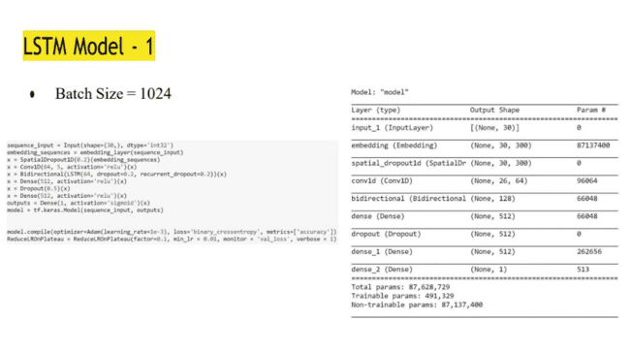
LSTM (Long Short-Term Memory) model, which is a type of neural network architecture commonly used for tasks involving sequential data, such as language modeling, machine translation, and speech recognition.
Key details:
Batch Size: The batch size is set to 1024, which means the model will process 1024 input sequences at a time during training.
Model Architecture: The model consists of various layers, including an InputLayer, an Embedding layer, a SpatialDropoutID layer, a ConvID layer, a Bidirectional layer, several Dense layers, and a Dropout layer. These layers define the structure of the neural network and the operations performed on the input data.
Layer Parameters: The image provides the output shape and parameter count for each layer in the model. For example, the Embedding layer has 30,300 parameters, and the ConvID layer has 96,064 parameters.
Total Parameters: The total number of parameters in the model is 87,628,729, of which 491,329 are trainable and 87,137,400 are non-trainable.
The specific purpose and architecture of this model are not explicitly stated, but the detailed layer information provides insights into the model's complexity and the types of operations it performs on the input data
Example:
Imagine you want to build a model that can predict the next word in a sentence, based on the previous words. This is a common task in natural language processing.
The LSTM model is well-suited for this kind of sequential data, where the order of the words matters.
Here's a simple example:
Let's say the input sentence is "The quick brown fox". The LSTM model would process this sentence word by word, in order.
The model starts with the first word "The". It takes this word as the input and tries to understand its meaning and context.
For the next word "quick", the model not only looks at the current word, but also remembers the previous word "The". This helps it understand the sequence and context better.
The model continues this process, remembering the previous words and using that information to predict the next word in the sequence.
The different layers in the LSTM model perform various functions:
The Embedding layer converts the words into numerical representations that the model can understand.
The LSTM layers remember the context and sequence of the words.
The Dense layers take the information from the LSTM layers and use it to predict the next word.
The model parameters, like the batch size and the number of layers, are tuned to optimize the model's performance on the specific language task.
So, in summary, the LSTM model is a powerful tool for processing sequential data, like text, by remembering the context and using it to make predictions about the next element in the sequence.

Slide 26
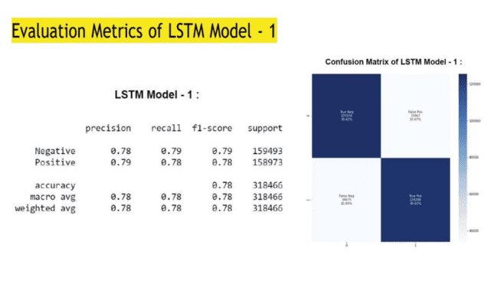
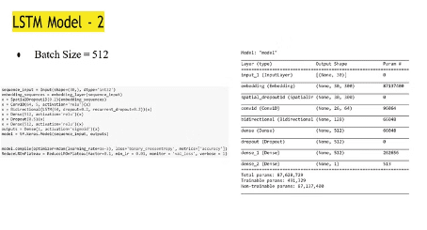
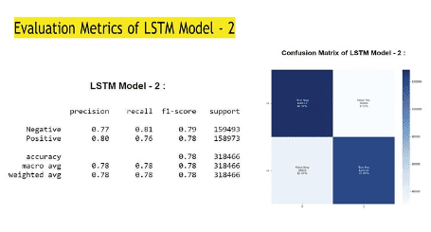
The image you sent is a visualization of the results of feature extraction using bag-of-words and TF-IDF. Let’s break that down:
Feature extraction is a technique used in machine learning to identify and extract important information from raw data. In the case of text data, features might be individual words or groups of words.
Bag-of-words is a common approach to feature extraction for text. It treats a document as a collection of words, ignoring grammar and word order. Each word is considered a feature, and the frequency of each word in the document is counted.
TF-IDF (term frequency-inverse document frequency) is a way to weight the features extracted from text data. Words that appear often in a single document but not in many documents overall are considered more important features. This is because they are more likely to be relevant to the content of that specific document.
The scatter plot in the image shows the correlation between these features (words) according to the TF-IDF weighting. Words are plotted based on two measures:
X-axis: TF-IDF weight of the word in a specific document
Y-axis: TF-IDF weight of the word across the entire corpus (all documents)
The color of the point corresponds to the sentiment of the word:
Red: Negative sentiment
Blue: Positive sentiment
By looking at the scatter plot, we can see which words tend to appear together in documents that have similar sentiment. For example, if we see a cluster of red dots in the upper right corner, this would indicate that there are words that frequently appear together in documents with a negative sentiment, and that these words also tend to have a high TF-IDF weight overall (i.e. they are important words across the corpus).

Slide 27
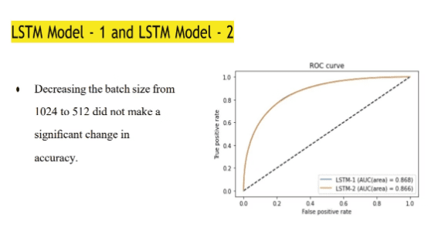

The image compares the performance of two LSTM (Long Short-Term Memory) models, LSTM-1 and LSTM-2, using a ROC (Receiver Operating Characteristic) curve.
Let's go through the key point about the models and explain it with an example:
The text states that "Decreasing the batch size from 1024 to 512 did not make a significant change in accuracy." This means that reducing the batch size, which is the number of samples processed in one iteration, did not significantly impact the model's performance.
For example, let's say the LSTM-1 model had an accuracy of 0.78 when the batch size was 1024, and an accuracy of 0.77 when the batch size was 512. The decrease from 0.78 to 0.77 is not considered a significant change, as it's a relatively small difference.
The ROC curve in the image shows the trade-off between the true positive rate (TPR) and the false positive rate (FPR) for the two LSTM models. The curves for LSTM-1 and LSTM-2 are very similar, indicating that the change in batch size from 1024 to 512 did not result in a significant difference in the models' overall performance.
The Area Under the Curve (AUC) values for LSTM-1 and LSTM-2 are both around 0.868, further supporting the idea that the change in batch size did not have a major impact on the models' ability to classify the data accurately.
In summary, the key point is that reducing the batch size from 1024 to 512 did not significantly affect the accuracy of the LSTM models, as demonstrated by the similar ROC curves and AUC values for both models.

Slide 28
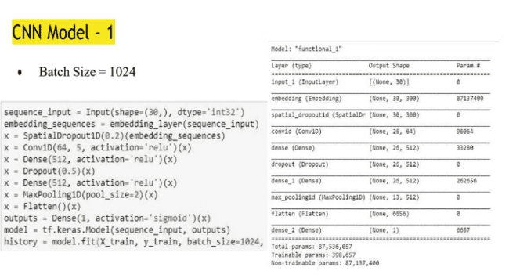
The image shows the configuration details of a CNN (Convolutional Neural Network) model, which is a type of deep learning model commonly used for tasks involving image processing and recognition.
Okay, let's explain the CNN model using a simpler example of classifying tweets as either positive or negative sentiment.
Imagine you want to build a model that can analyze tweets and determine if the sentiment expressed is positive or negative. A CNN model would be well-suited for this task.
Here's how the CNN model "functional_1" might work:
Batch Size: The batch size is set to 1024, which means the model will process 1024 tweet texts at a time during training.
For example, the model might take in a batch of 1024 tweets and process them all together, rather than looking at each tweet one by one.
Model Architecture:
The Input layer takes in the tweet text as the input.
The Embedding layer converts the words in the tweets into numerical representations that the model can understand.
The Convolutional layers (ConvID) then analyze the numeric tweet representations and extract important features, like keywords or phrases that indicate positive or negative sentiment.
The Dense layers take these extracted features and use them to classify the tweets as either positive or negative.
The Flatten layer prepares the data to be fed into the final Dense layer for the classification output.
This architecture allows the model to learn patterns in the tweet text and use that information to accurately classify the sentiment.
Layer Parameters: The model has a total of 87,536,057 parameters, with 398,657 trainable parameters that can be updated during the learning process.
These parameters represent the internal weights and biases of the neural network, which the model adjusts to improve its ability to classify tweets correctly as positive or negative.
In summary, this CNN model is designed to take in batches of tweet texts, extract relevant features using the convolutional and dense layers, and then classify the tweets as either positive or negative sentiment. The specific architecture and parameters of the model are optimized to perform well on this tweet classification task.

Slide 29
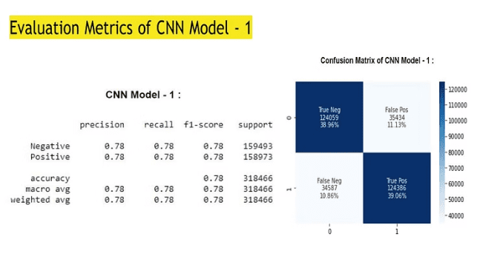
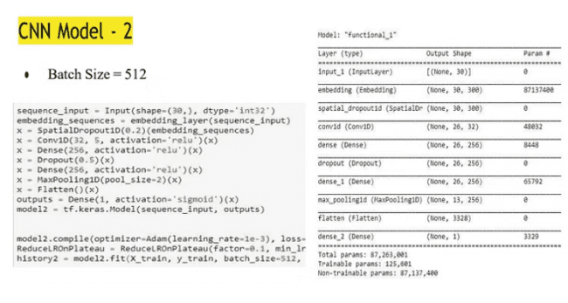
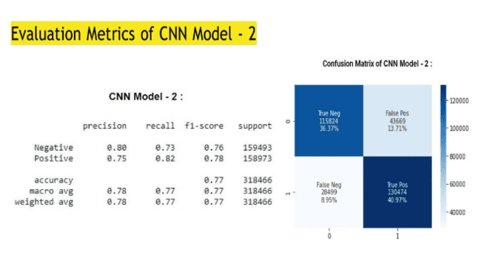
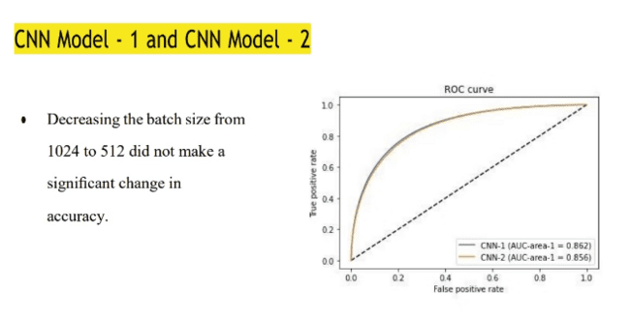

Slide 30
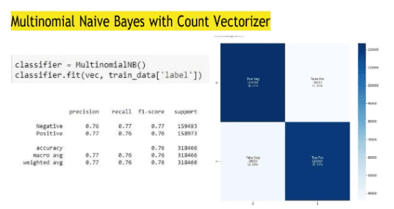
The image presents a Multinomial Naive Bayes model with a Count Vectorizer, which is a machine learning algorithm used for text classification tasks.
Key points:
Model Implementation: The code snippet shows how the Multinomial Naive Bayes model is implemented and trained on the 'train_data' with the 'label' as the target variable.
Evaluation Metrics: The table displays the performance metrics of the model, including precision, recall, F1-score, and support. The model achieves a precision, recall, and F1-score of 0.77 for both the Negative and Positive classes.
Confusion Matrix: The confusion matrix plot visualizes the true positive, true negative, false positive, and false negative counts for the model's predictions. The true negative count is 159,493, and the true positive count is 158,973, indicating the model's ability to accurately classify the Negative and Positive instances.
ROC Curve: The ROC (Receiver Operating Characteristic) curve shows the trade-off between the true positive rate and the false positive rate for the model's predictions. The area under the curve (AUC) is a measure of the model's overall performance, with a higher AUC indicating better classification ability.
In summary, this Multinomial Naive Bayes model with a Count Vectorizer is a text classification algorithm that has been trained and evaluated on a dataset. The performance metrics and visualization provide insights into the model's capability to distinguish between Negative and Positive classes in the given data.

Slide 31
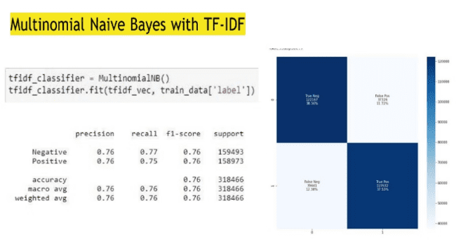
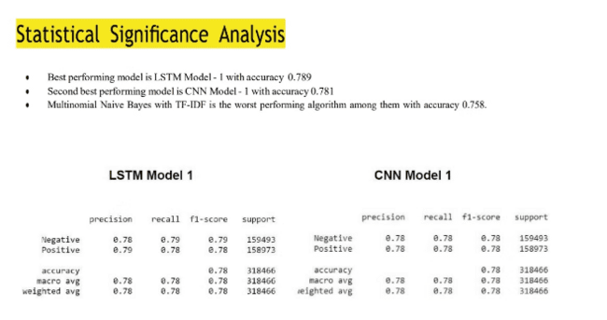
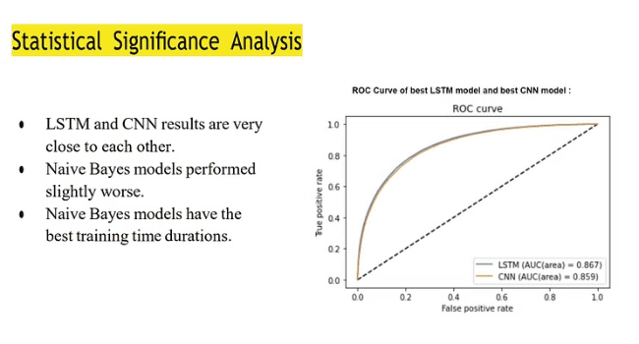
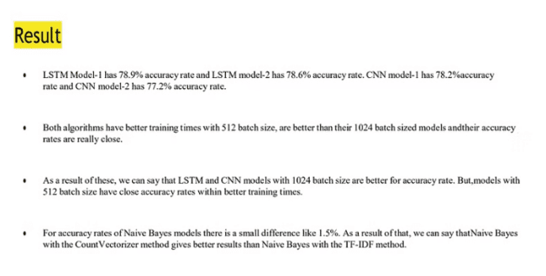

Slide 32
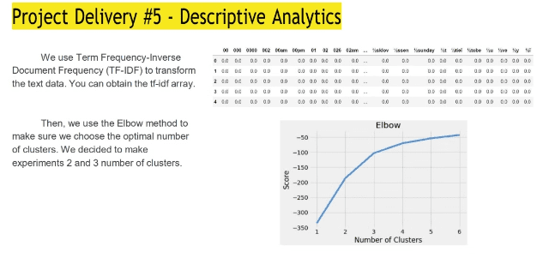
What is cluster ?
A cluster is a group of similar data points within a dataset. In the context of data analysis, clustering refers to the task of grouping a set of objects in such a way that objects in the same group (cluster) are more similar to each other than to those in other groups.
For example, imagine you have a dataset of customer data for an e-commerce platform. This data includes features such as age, spending habits, and shopping preferences for each customer. By using clustering algorithms, you can group similar customers together into clusters. Customers within the same cluster may share common characteristics, such as similar spending patterns or demographic profiles.
In summary, a cluster represents a collection of data points that are similar to each other based on certain characteristics or features, and clustering is the process of identifying and grouping these similar data points together
Text Data Transformation:
Text data, like customer reviews or feedback, is converted into numerical form.
TF-IDF (Term Frequency-Inverse Document Frequency) method is used for this transformation.
TF-IDF considers both how often words appear in each text (Term Frequency) and how unique those words are across all texts (Inverse Document Frequency).
Each word is given a score representing its importance in a specific text.
Finding the Optimal Number of Groups:
The goal is to group texts based on their content.
The Elbow method helps determine the best number of groups (clusters) for this task.
It's analogous to finding the ideal number of drawers to organize clothes.
Start with a guess, like 2 or 3 clusters, then assess how well the data fits into these clusters.
Using the Elbow Method:
Plot a graph with the number of clusters on the x-axis and a measure of cluster quality on the y-axis.
This measure could be the sum of squared distances of samples to their assigned cluster centers.
The graph resembles how well clothes fit into different numbers of drawers.
Look for the "elbow" point on the graph, where adding more clusters doesn't significantly improve organization.
Final Step:
Once the "elbow" point is identified, it indicates the optimal number of clusters.
Assign each text to its corresponding cluster based on TF-IDF scores.
This clustering helps reveal patterns and themes in the text data, aiding analysis and insight extraction.

Slide 33
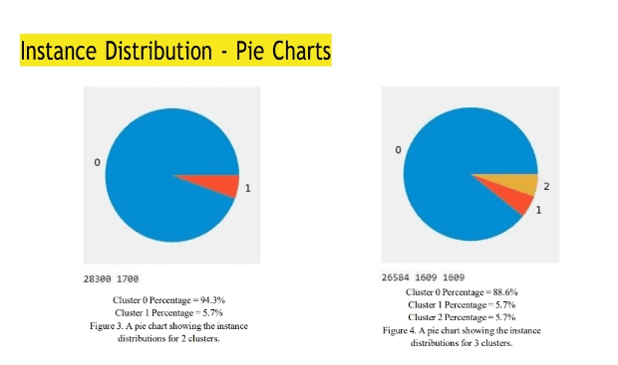
These pie charts illustrate the distribution of instances across different clusters. Here's what we can gather from them:
Cluster Representation: Each pie chart represents a different scenario: one for 2 clusters (left), and another for 3 clusters (right).
Color Segmentation: The segments in each pie chart represent the different clusters. In the left chart, there are two segments (blue and red), while in the right chart, there are three segments (blue, orange, and red).
Instance Distribution: The size of each segment indicates the proportion of instances assigned to that cluster. For example, in the left chart, the blue segment is larger, indicating that more instances belong to Cluster 0 compared to Cluster 1.
Percentage Representation: The text below each chart provides the percentage representation of each cluster. This tells us the proportion of instances assigned to each cluster out of the total instances analyzed. For instance, in the right chart, Cluster 0 represents 88.6% of the instances, while Cluster 1 and Cluster 2 each represent 5.7% of the instances.

Slide 34



Conclusion
Best Model
Training Time
Future Work
The LSTM Model-1 with a batch size of 1024 emerged as the best performing model, achieving an accuracy of 78.9% and the highest AUC score of 0.867.
While the Naive Bayes models had the fastest training times, the LSTM and CNN models with a batch size of 512 offered a good balance between training time and accuracy.
Future work could involve exploring other feature engineering techniques, experimenting with ensemble models, and applying the sentiment analysis models to different domains or datasets.

Slide 35



